Slide 1
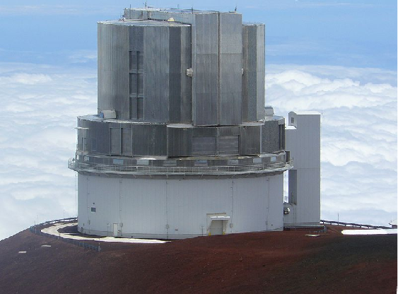
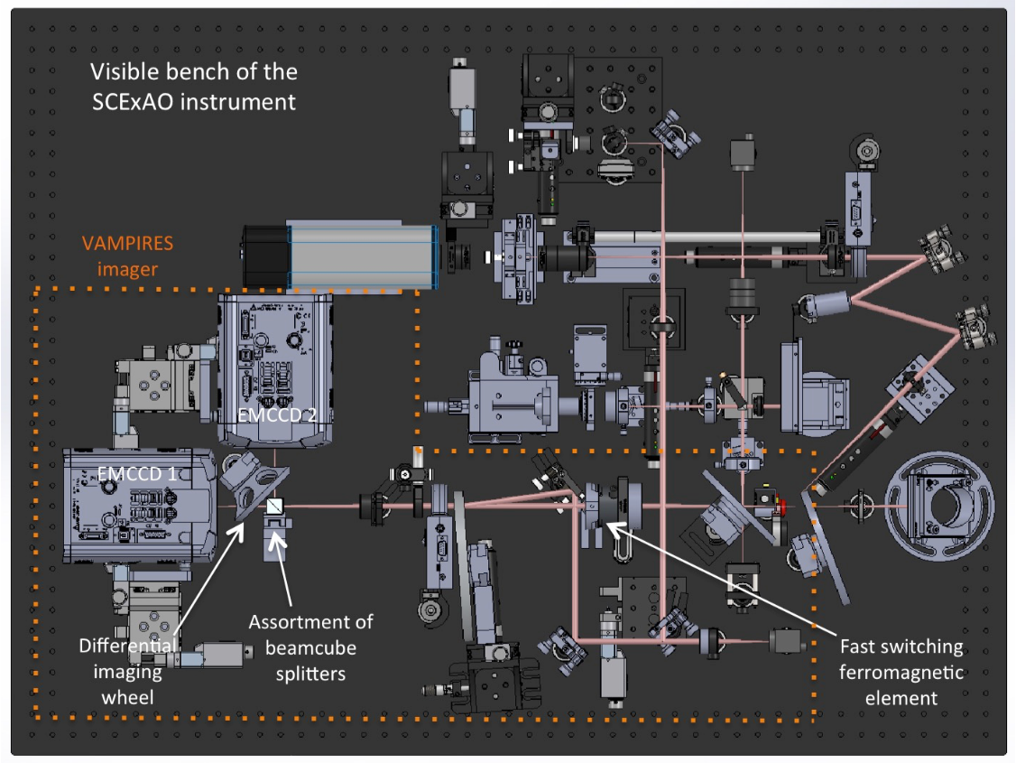
Background - The VAMPIRES Instrument
Polarimetric aperture masking and imaging in the visible
Aperture masking - Diffraction limited imaging through the atmosphere… …resolution of 10s mas
Differential polarimetry - imaging scattered starlight
Precision differential calibration beats the contrast problem (triple-differential)
Measurement of dust grain type, size
‘Hitch-hiker instrument’ - operates on visible channel of SCExAO on Subaru telescope, simultaneous with IR observations (e.g. CHARIS)

Slide 2
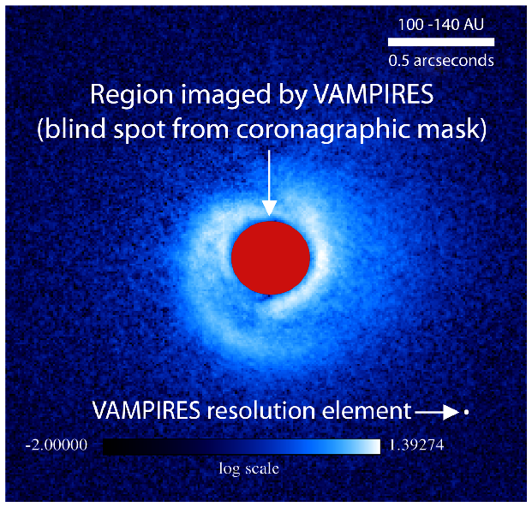
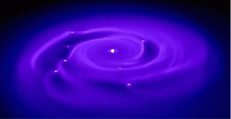
SCIENCE CASE: Imaging the inner region of proto-planetary disks at solar-system scales
Inner region (10’s of AU) critical for understanding planet formation and disk structure
Precise measurement of transition disk gaps and inner disk
Density perturbations from massive bodies within disk (e.g. warps, spirals)
Gravitationally bound clumping dust immediately surrounding forming planets
Dust grain species and size determination
Complementary to coronagraphy
Resolution ~10 mas; 0.5λ/D
~1 AU at 100 pc
NRM F.O.V. ~500 mas, PDI ~3 arcsec
Scattered starlight, not thermal
MWC758 - Base image: Grady et al., ApJ, 2013
Hydrodynamical modelling of gravitational collapse of protoplanetary disk, with resulting fragmentation causing gravitationally bound clumps Mayer L., et al., 2007, ApJ 661 77
Notes:
Basically any dusty circumstellar environment. Obvious ones are protoplanetary disks and mass-loss shells, but could be other uses (eg AGN)

Slide 3
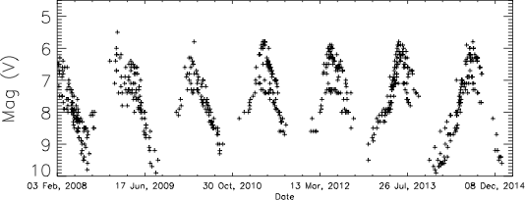
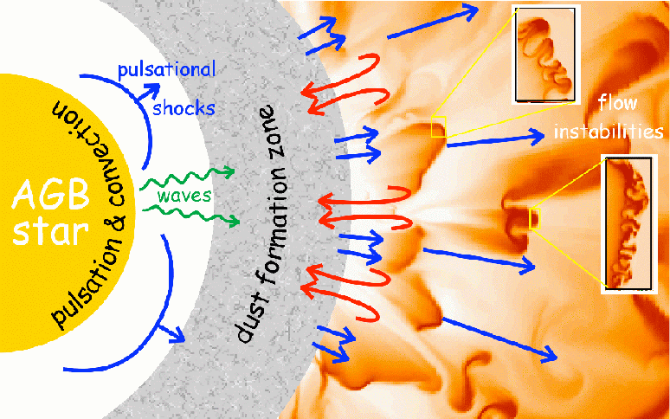
SCIENCE CASE: Imaging the inner mass-loss region of evolved stars
Mass-loss process poorly understood
Ejected material comprises next generation of stars & planets
What drives this wind?
Directly image inner dust condensation region, explore grain size and composition (polarimetry)
Origin of asymmetries
Asymmetries observed at wide scales - where do they originate?
At star (effect of stellar atmosphere) or interstellar medium?
Extension of red giant atmospheres
Does radiative pressure on dust in atmosphere contribute to extension?
W Hya light curve (AAVSO)
Peter Woitke: http://www.strw.leidenuniv.nl/~woitke/AGB_popular.html

Slide 4
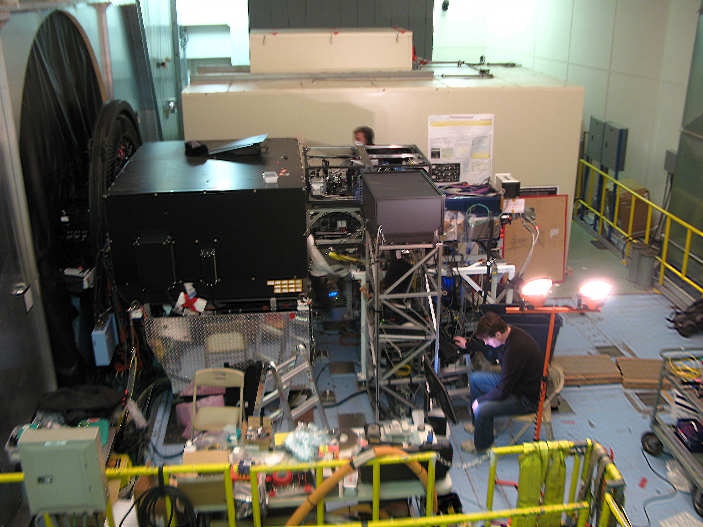
Nuts and bolts: VAMPIRES within SCExAO
SCExAO
HICIAO
AO188
Subaru IR Nasmyth platform

Slide 6
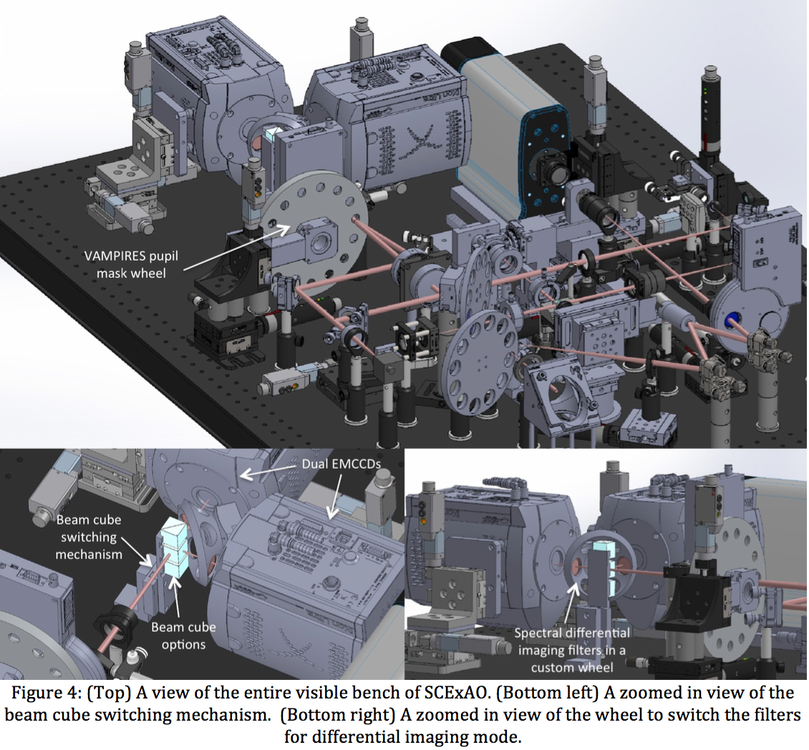
New mode - Differential spectral line imaging - Hɑ, SII Operates double-differential to calibrate NCP

Slide 7
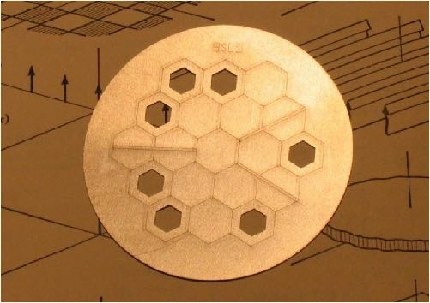
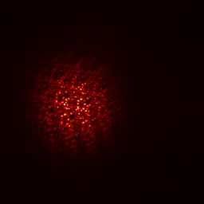
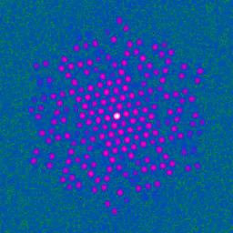
Diffraction limited imaging through atmosphere: One method: Non-Redundant Masking
State of the art 10m telescope: - Diffraction limit ~ 10 mas - Seeing limited ~ 1000 mas
The goal: mitigate the effect of the turbulent atmosphere to allow diffraction limited, high contrast imaging.
Closure phase independent of phase
y - Measured baseline phase
f - Actual baseline phase
e - error from atmosphere
y12 = f12 + e2
y23 = f23 + e3 - e2
y31 = f31 - e3
C.P. = y12 + y23 + y31 = f12 + f23 + f31
Aperture masking interferometry present state of art
—> Each and every hole-pair is baseline of interferometer
—> Recover diffraction limited performance
Visibilities - a power spectrum, independent of phase
1
2
3

Slide 8


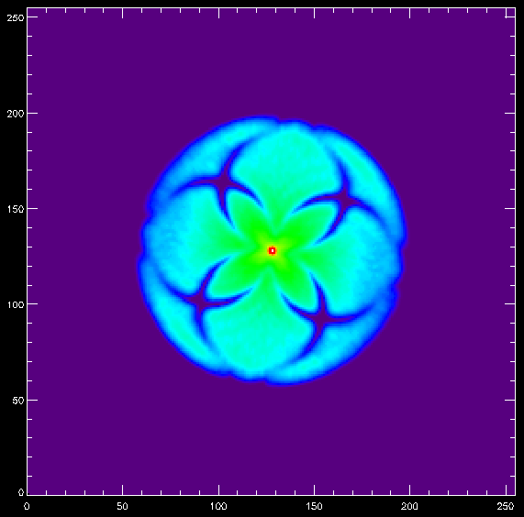
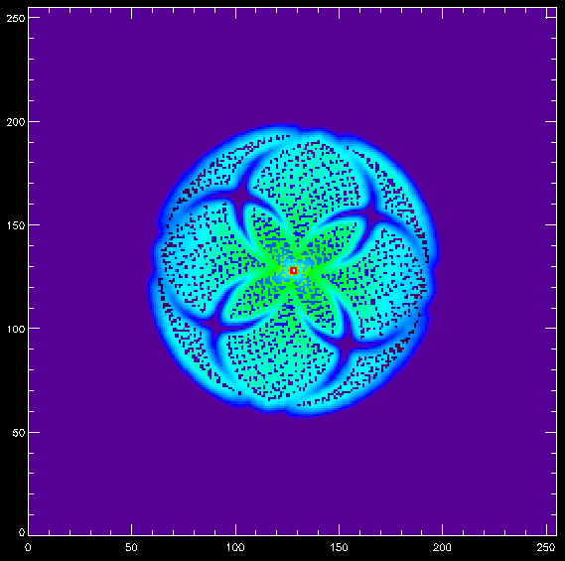
Power spectrum example: annulus
Discrete sampling of Annulus PS Excellent Fourier coverage, arbitrarily short baselines.
Vega, 4s integration

Slide 9
Differential calibration - in an ideal world…
H polarisation image ⭑ Error (seeing, systematics)
V polarisation image ⭑ Error (seeing, systematics)
FT
FT
H polarisation visibilities x Error visibilities
V polarisation visibilities x Error visibilities
V/H polarisation visibilities
(CLEAN OBSERVABLE)
÷
=

Slide 10
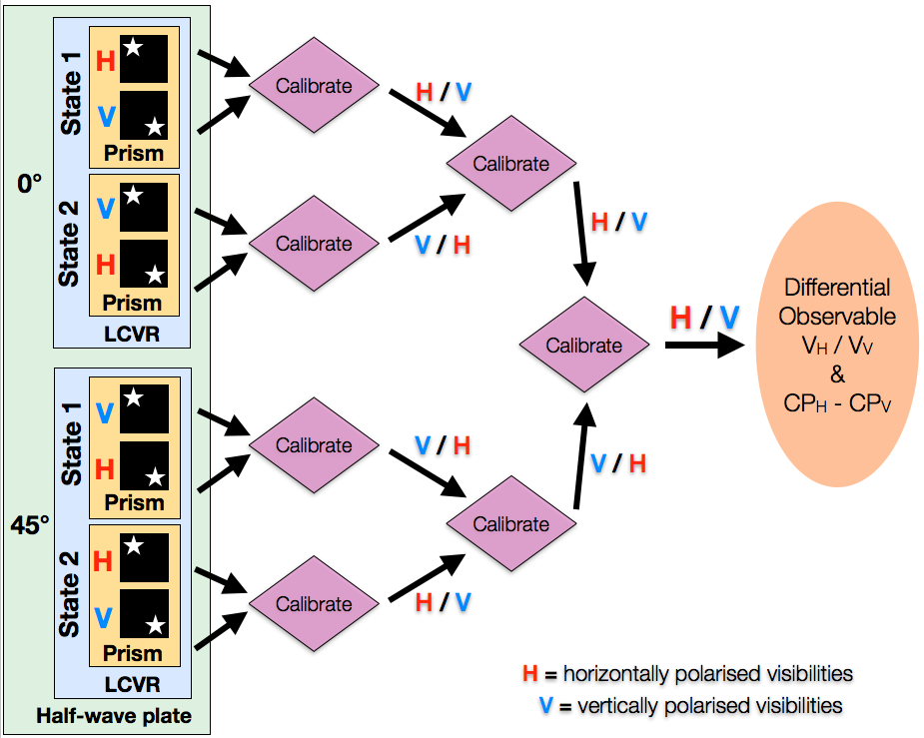
Differential calibration - triple layer switching!
Address non-common-path & non-simultaneous errors

Slide 11
Differential calibration - triple layer switching!
Address non-common-path & non-simultaneous errors
Liquid crystal variable retarder
Polarising beamsplitter!
Half-wave Plate!
1 2 quarter wave plates

Slide 12
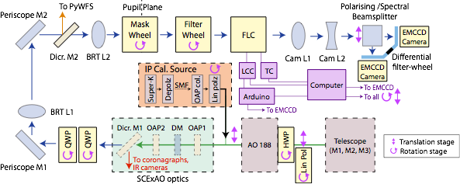
Differential calibration - triple layer switching!
Address non-common-path & non-simultaneous errors

Slide 13


Differential calibration - triple layer switching!
Address non-common-path & non-simultaneous errors

Slide 14
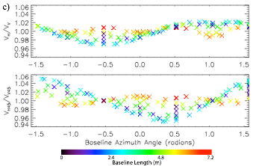

Necessary Technical note…
Effective way of plotting calibrated VAMPIRES data is with a polarised visibility ratio plot:
Y Axis:
Ratio of horizontally-polarised to vertically-polarised interferometric visibilities (Fourier power)
Synthetic example data
2 plots: Correspond to Stokes Q and U coordinates
X Axis:
Azimuthal angle (on-sky) of the baseline (spatial frequency coordinate)
Color scale:
Baseline length (on-sky) (abs value value of spatial frequency coordinate)
Should = 1 for all unpolarised targets…
Demonstrates calibration precision
Notes:
Need to briefly explain this to understand next slide

Slide 15
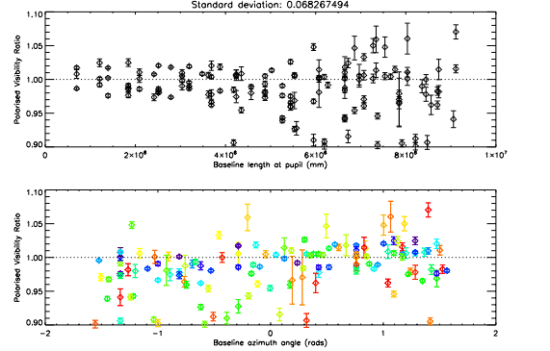
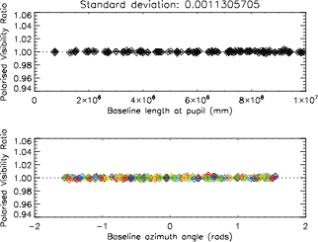
NRM mode CALIBRATION PERFORMANCE
Demonstrated polarised-differential NRM visibility calibration to 1 part in 10^3 per baseline.
Roughly speaking, achievable contrast at 0.5𝜆/D (10 mas) goes as √nBaselines - DOF
Conventional 2-beam polarimetry
Triple-differential calibration

Slide 16
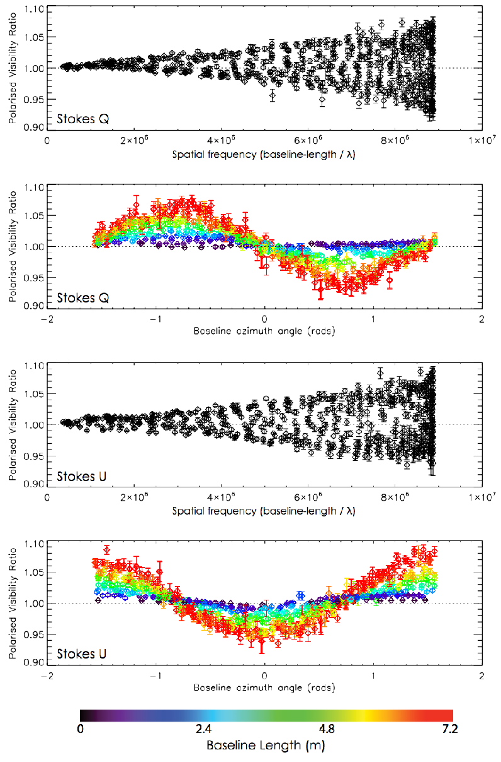
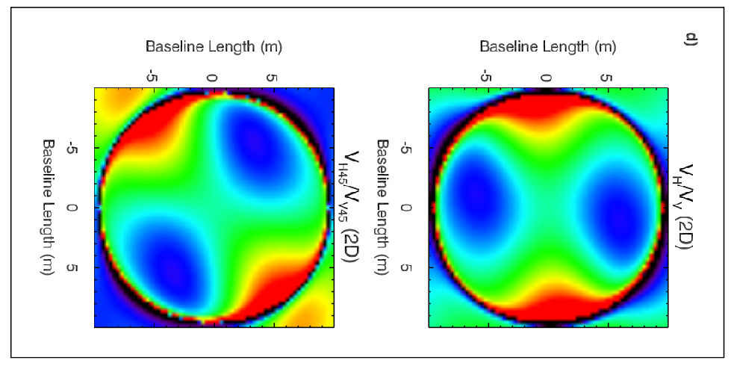
NRM-MODE example Science-RESULT
Investigation of supergiant mass-loss via direct imaging of Circumstellar dust around Red Supergiant μ Cephei
Observed with annulus mask at 775 nm
Raw differential polarized visibilities show distinctive sinusoidal signature of circumstellar dust shell, with clear asymmetry (right)
Dust scattering model fitted via synthetic differential visibilities (below)

Slide 17
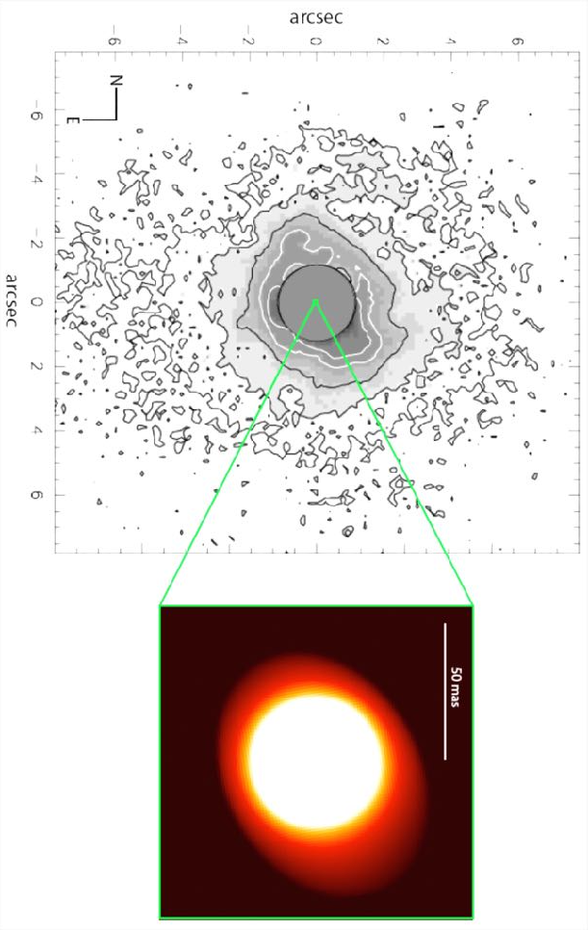
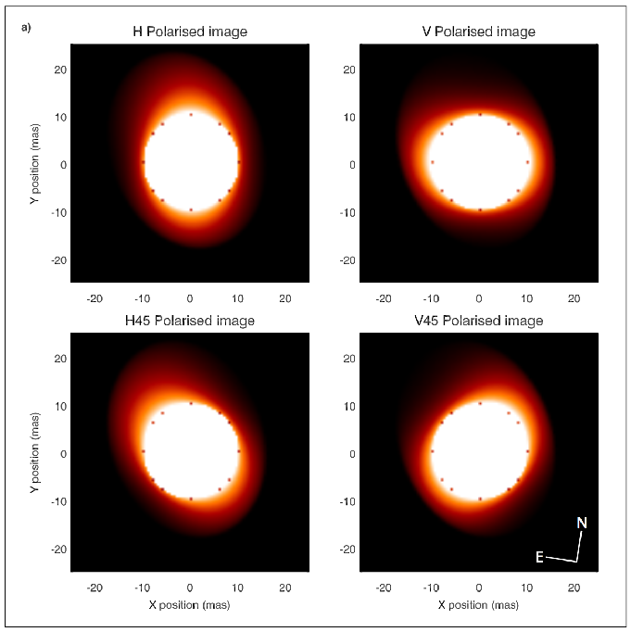
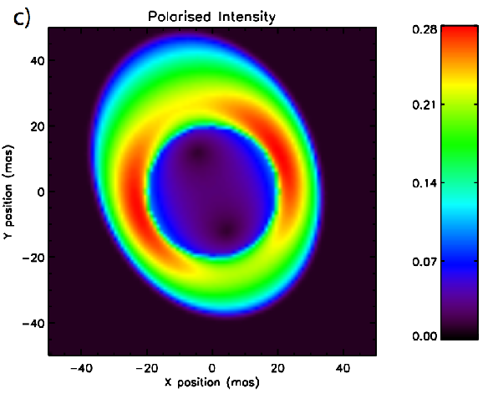
NRM-MODE example Science-RESULT
Model-fitting reveals extended, asymmetric dust shell, originating within the outer stellar atmosphere, without a visible cavity. Such low-altitude dust (likely Al₂O₃) important for unexplained extension of RSG atmospheres.
Inner radius: 9.3 ± 0.2 mas (which is roughly R_{star})
Scattered-light fraction: 0.081 ± 0.002
PA of major axis: 28 ± 3.7 ° • Aspect ratio: 1.24 ± 0.03
Left: model image, shown in polarized intensity. Middle: model image show in four polarisations. Right: Model image (intensity), shown with wide field MIR image (from de Wit et al. 2008 – green box shows relative scales. Axis of extension in MIR image aligns with the close-in VAMPIRES image.

Slide 18
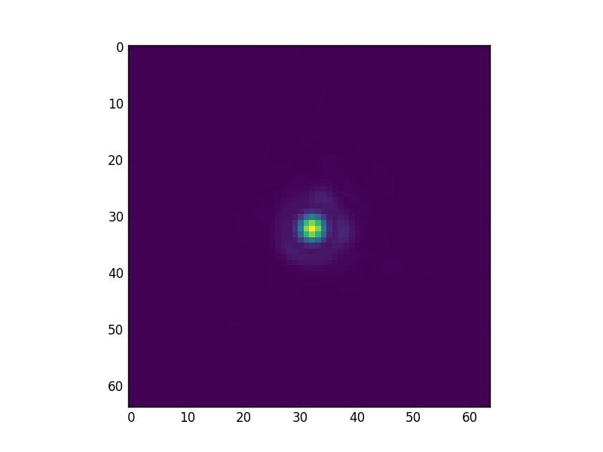
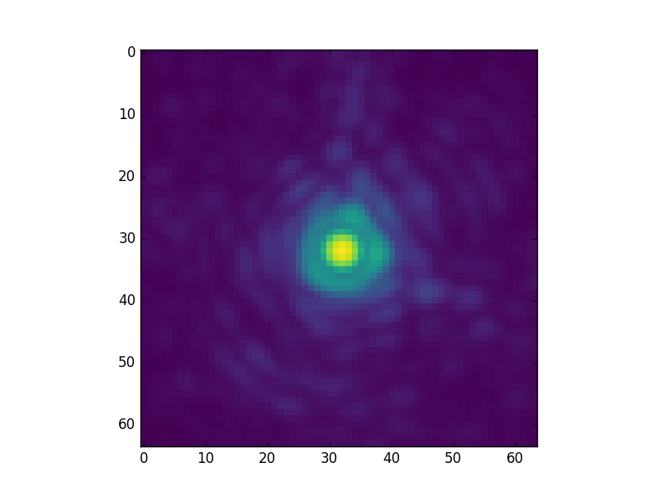
Imaging/PDI mode
High-speed acquisition and polarisation switching rate (up to 500 Hz) - allows offline tip/tilt correction and ‘lucky imaging’ approach, unlike CCD-shuffle based systems
Example: 750 nm PSF, 100 frames/sec, discard 80% lowest-Strehl frames, align and sum (~30 secs of data)

Slide 19
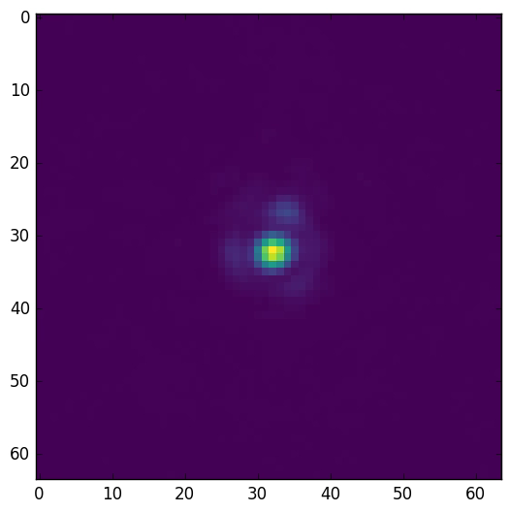
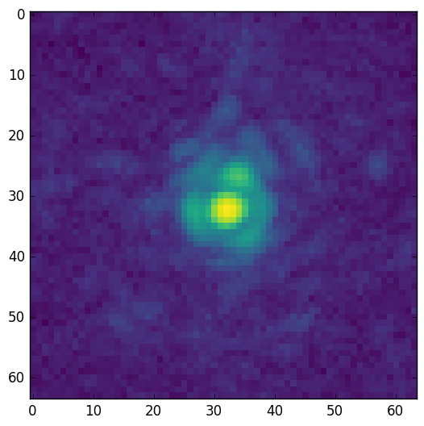
Imaging/PDI mode
SCExAO yields excellent correction at visible wavelengths
Example: basic alignment and top 20% of frames, acquired at 100 fps, played back at 25 fps

Slide 20
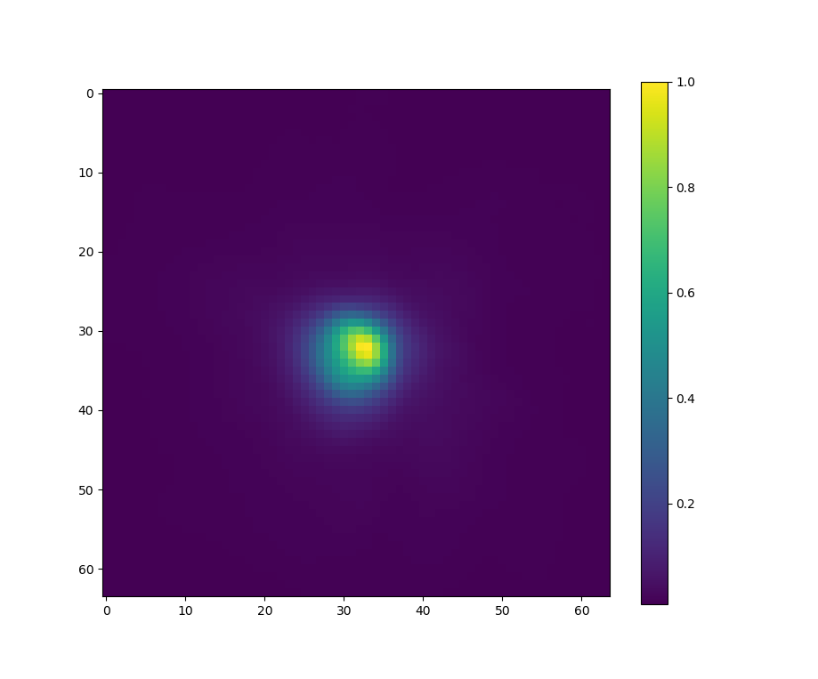
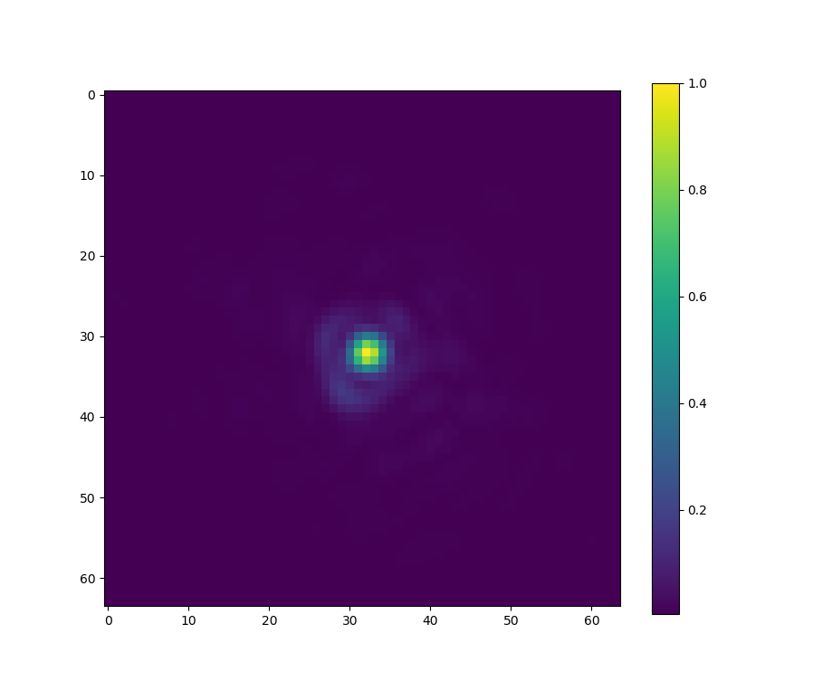
IMAGING-MODE example Science-RESULT
Direct imaging of omi Cet - clear asymmetry seen.
Speckle imaging - diffraction-limited
omi Cet
PSF ref (63 Cet)
6 mas / px
FWHM = ~18 mas
𝛌 / D = 19.3 mas
100 mas
100 mas
Observed 12/09/2017

Slide 21
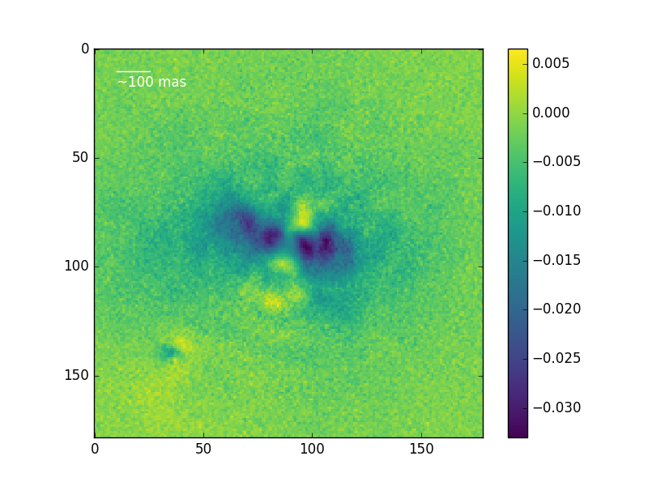
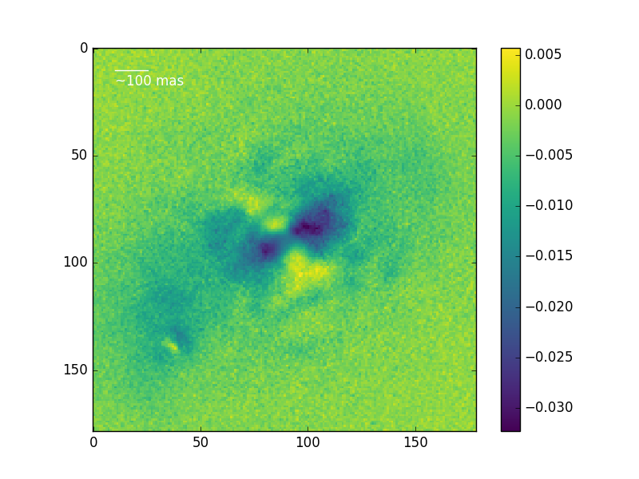
IMAGING-MODE example Science-RESULT
Observation of omi Cet - dust shells and disk around omi Cet b observed
Very preliminary reduction
Inner shell ~ 2R★
Gap & 2nd shell
Gap & 2nd shell
Inner shell ~ 2R★
Dust transfer?
omi Cet b disk
omi Cet b disk
Stokes Q
Stokes U
Observed 12/09/2017

Slide 22
IMAGING-MODE example Science-RESULT
Effect of single vs triple polarisation calibration
3-layer PDI
Stokes Q

Slide 23
IMAGING-MODE example Science-RESULT
Disk around AB Aur
fractional P
Stokes Q
Stokes U
100 mas

Slide 24
IMAGING-MODE example Science-RESULT
Disk around AB Aur
Stokes Q
Stokes U
100 mas

Slide 25
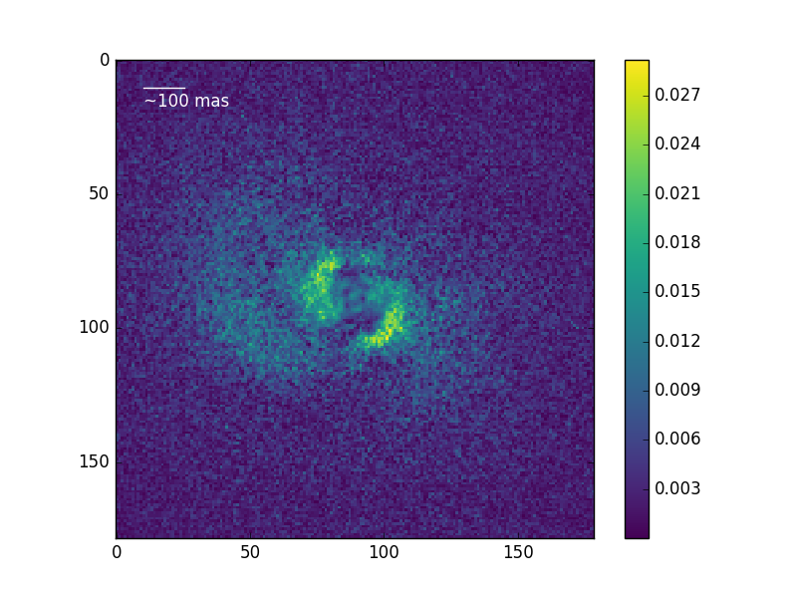
IMAGING-MODE example Science-RESULT
Disk around AB Aur - poorer seeing
fractional P

Slide 26
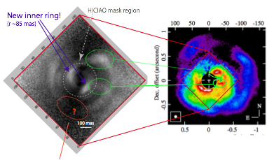
IMAGING-MODE example Science-RESULT
Observation of AB Aur - new inner-regions of disk identified
Preliminary reduction, optimal pipeline in development
Radial gap - real?

